Slide 1
CPRE557 Computer Graphics
He Yang
Electrical and Computer Engineering（ECPE）

Slide 2
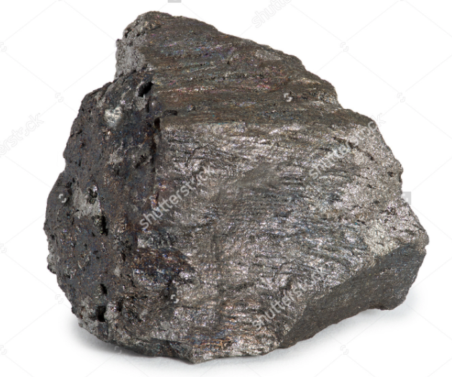
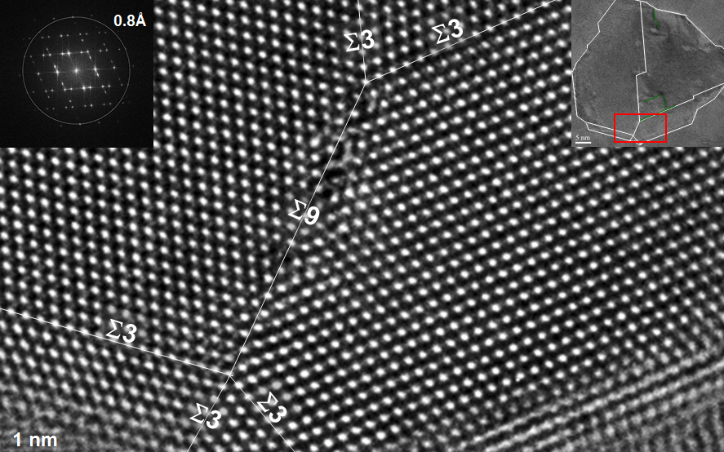
Construct Iron-atom Model by techniques of computer graphics
Fig1. Appearance of Iron
Fig2. Microstructure of Iron showing iron atoms

Slide 3
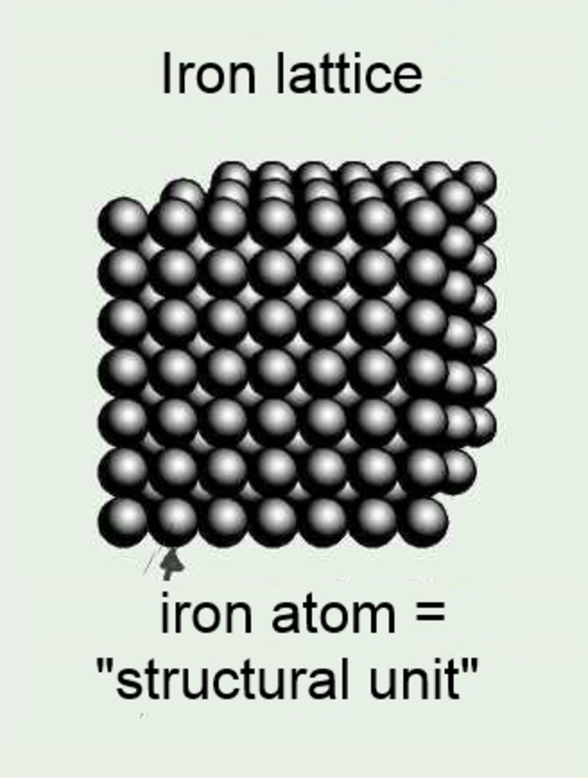
Lattice：Arrangement of atoms
To get a more explict view: https://www.youtube.com/watch?v=uKpr-9vmgsc
Fig 3. Lattice of Iron

Slide 4
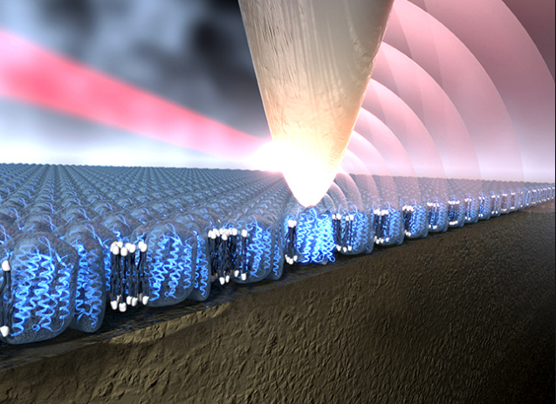
Fig4. Movement of Iron atom driven by nano-tip

Slide 5
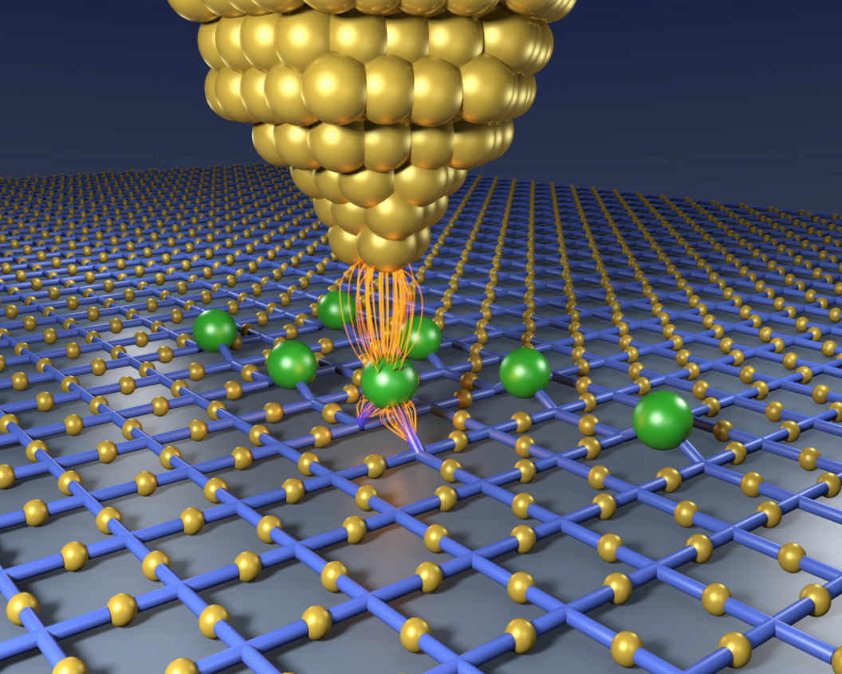
Fig5. Movement of Iron atom driven by nano-tip

Slide 6
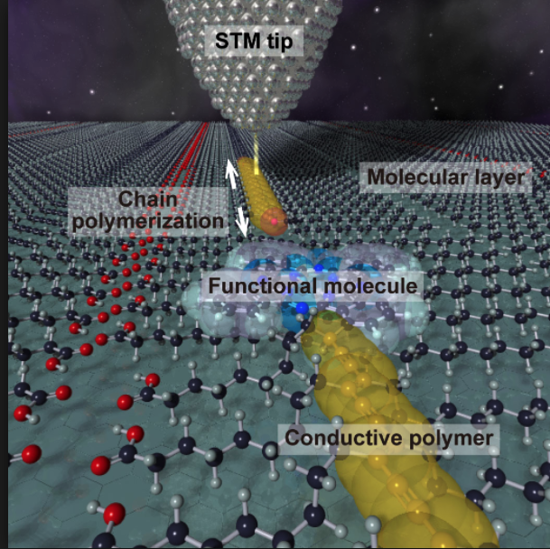
Fig6. Movement of Iron atom driven by nano-tip

Slide 7
CG techniques used to build this model
primitive rendering
light and material simulation
texturing
Navigation
animation

Slide 8
primitive rendering
— Hierarchical model or Multiple primitives
light and material simulation
— Combined light on surface
texturing :
— render with a metallic texture
Navigation:
— at least trackball navigation to give a 360 °
view.

Slide 9
Animation
— to mimic atom movement
on the iron lattice surface

Slide 10
Thanks

